Slide 1

Debugging made simple.

Slide 2
Why?
System.out.println() lacks features
Inspection
Advanced formatting
Images
Colors

Slide 3
Why?
Debuggers lack features
Comparison between points in time
Customized output

Slide 4
Solution: DoodleDebug
Print an object with Doo.dle(object);
Multiple calls list doodles one below each other
Easily installed as Eclipse plugin
Notes:
-
- Similar to Sysout

Slide 5
Customization
Implement the Doodleable interface
doodleOn(DoodleCanvas) Regular representation
summarizeOn(DoodleCanvas) Simplified representation for nested objects

Slide 6
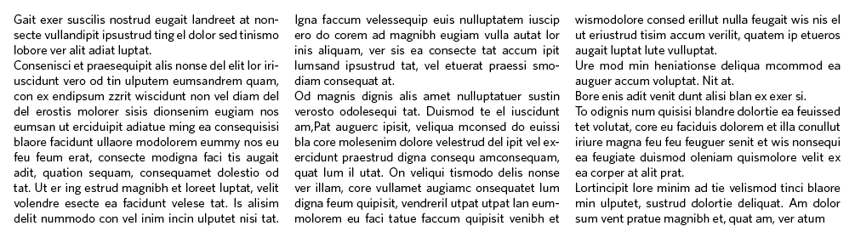
DoodleCanvas
Paradigm of text formatting
draw(Object) Draws an object to this canvas
newLine() Does a line break
newColumn() Creates a now column on the right

Slide 7
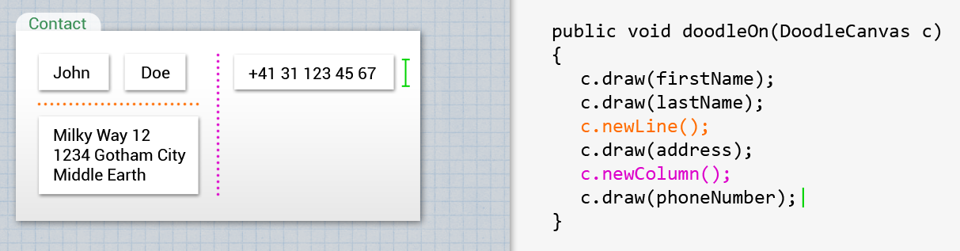
DoodleCanvas

Slide 8
Plugins
Interface RenderingPlugin
For convenience: AbstractPlugin
Define types to be rendered
Generate HTML, CSS

Slide 9
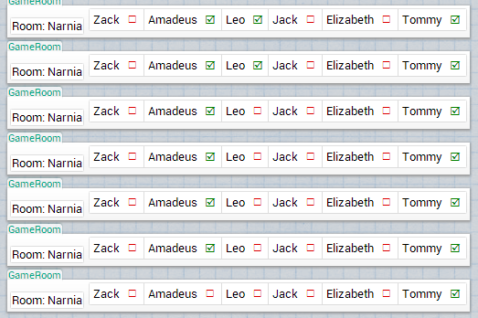
Changes Over Time

Slide 10
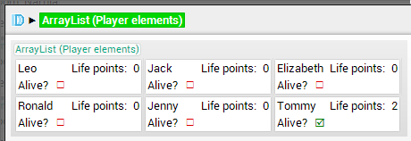
Changes Over Time

Slide 11
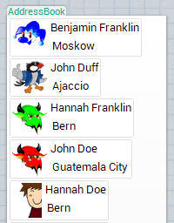
Inspecting Doodles

Slide 12
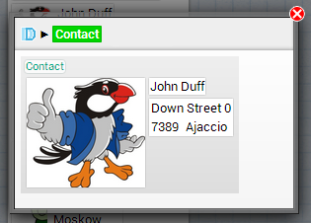
Inspecting Doodles

Slide 13
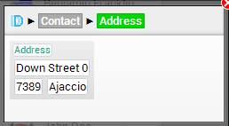
Inspecting Doodles

Slide 14
Default Renderings
Most common types included
Primitives and strings
Nulls
Arrays and Collections
Maps
Colors
Images (several types)
Classes

Slide 15
Default Renderings
Objects List fields (if not too many)
Tables and Matrices Two-dimensional arrays and collections
Throwables With linking to Eclipse editor

Slide 16
Study: Setup
Qualitative
7 subjects
3 problems
Alternatively with or without DoodleDebug
Screen capturing and think-aloud protocol

Slide 17
Study: Outcomes
More efficient debugging
Less program executions
Less searching effort
Default doodles should not only use toString() → Listing fields yields better results
Several minor UI problems

Slide 18
Demo
Do not read this

